Slide 1
Results from an Ensemble Reanalysis with the Community Earth System Model 2.1 Kevin Raeder, Jeff Anderson, Tim Hoar, Nancy Collins, Moha El Gharamti NCAR/CISL Data Assimilation Research Section

Slide 2
Motivation for an Ensemble Reanalysis with CAM
1. Evaluate weather prediction capabilities of CAM.
Confront climate model with observations.
Identify systematic short-term forecast errors.
Compare to earlier CAM reanalysis.
2. Provide forcing for CESM component model simulations and reanalyses.
POP ocean model.
CLM land surface.
CICE sea ice model.
Offline chemistry transport models.
Notes:
I am interested in Ensemble DA which involves running multiple instances of the model that differ only in their initial state –
this represents our uncertainty in our knowledge of the state of the system.
The first public release of DART was in 2004 and the seminal review paper is from 2009.
I want to make sure that we understand each other and when I say ‘data assimilation’ I am referring to confronting a model state with observations and updating the model state to reflect the information in the observations. DART additionally allows one to augment the state with parameters which can be estimated – which is of interest to the rest of the team – but that’s a topic for a different talk.

Slide 3
Reanalysis Quick Facts: Model
Model:
CESM 2.1 release, also used for CMIP 6.
Atmosphere: CAM6 0.9 degree latitude by 1.2 degree longitude, 32 levels.
Land: CLM 5.0 BGC-CROP version, same grid as CAM.
SST and Sea Ice Coverage: Specified daily 0.25 degree from AVHRR.
Sea Ice Thickness from CICE model.
Aerosols, greenhouse gases, volcanic forcing: from CESM when available.
Notes:
I am interested in Ensemble DA which involves running multiple instances of the model that differ only in their initial state –
this represents our uncertainty in our knowledge of the state of the system.
The first public release of DART was in 2004 and the seminal review paper is from 2009.
I want to make sure that we understand each other and when I say ‘data assimilation’ I am referring to confronting a model state with observations and updating the model state to reflect the information in the observations. DART additionally allows one to augment the state with parameters which can be estimated – which is of interest to the rest of the team – but that’s a topic for a different talk.

Slide 4
Reanalysis Quick Facts: Assimilation
Assimilation:
DART Manhattan.
80 members.
6-hour window.
Updated adaptive inflation.
Tuned parameters for localization, inflation.
Notes:
I am interested in Ensemble DA which involves running multiple instances of the model that differ only in their initial state –
this represents our uncertainty in our knowledge of the state of the system.
The first public release of DART was in 2004 and the seminal review paper is from 2009.
I want to make sure that we understand each other and when I say ‘data assimilation’ I am referring to confronting a model state with observations and updating the model state to reflect the information in the observations. DART additionally allows one to augment the state with parameters which can be estimated – which is of interest to the rest of the team – but that’s a topic for a different talk.

Slide 5
Reanalysis Quick Facts: Observations
Observations assimilated:
Temperatures and winds from radiosondes, ACARS and aircraft.
Cloud motion vector winds.
GPS radio occultation refractivity.
AIRS temperature retrievals.
Observations evaluated:
Radiosonde specific humidity.
AIRS specific humidity retrievals.
Radiosonde, land and marine altimeter.
Notes:
I am interested in Ensemble DA which involves running multiple instances of the model that differ only in their initial state –
this represents our uncertainty in our knowledge of the state of the system.
The first public release of DART was in 2004 and the seminal review paper is from 2009.
I want to make sure that we understand each other and when I say ‘data assimilation’ I am referring to confronting a model state with observations and updating the model state to reflect the information in the observations. DART additionally allows one to augment the state with parameters which can be estimated – which is of interest to the rest of the team – but that’s a topic for a different talk.

Slide 6
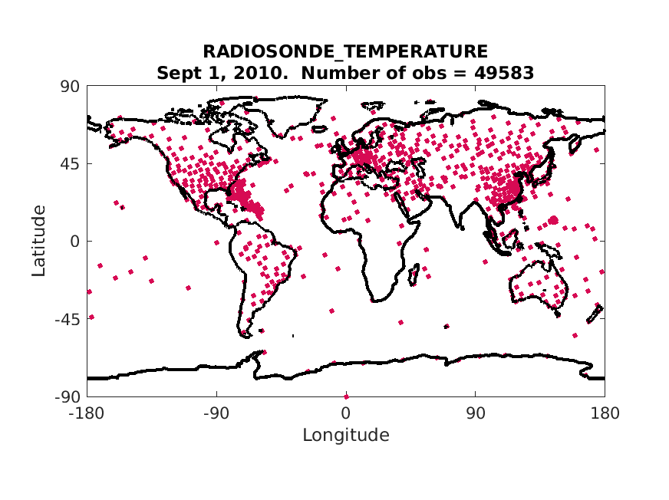
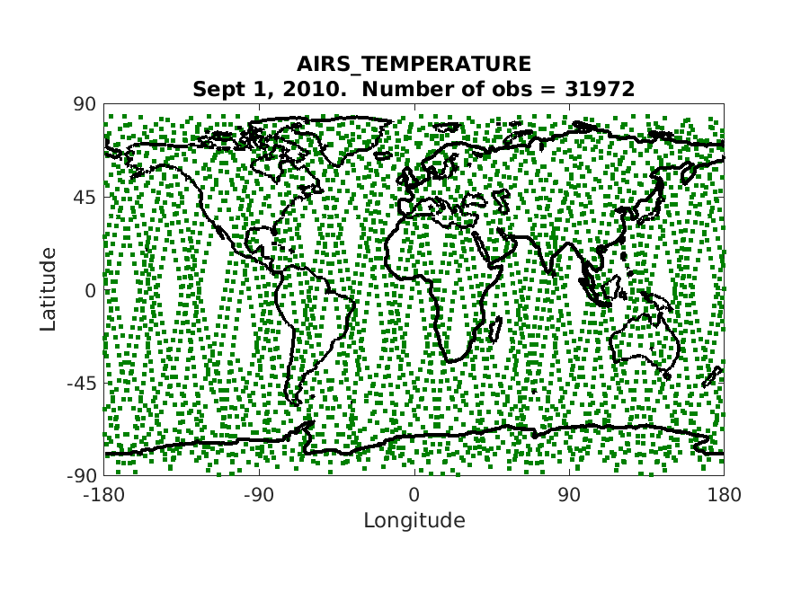
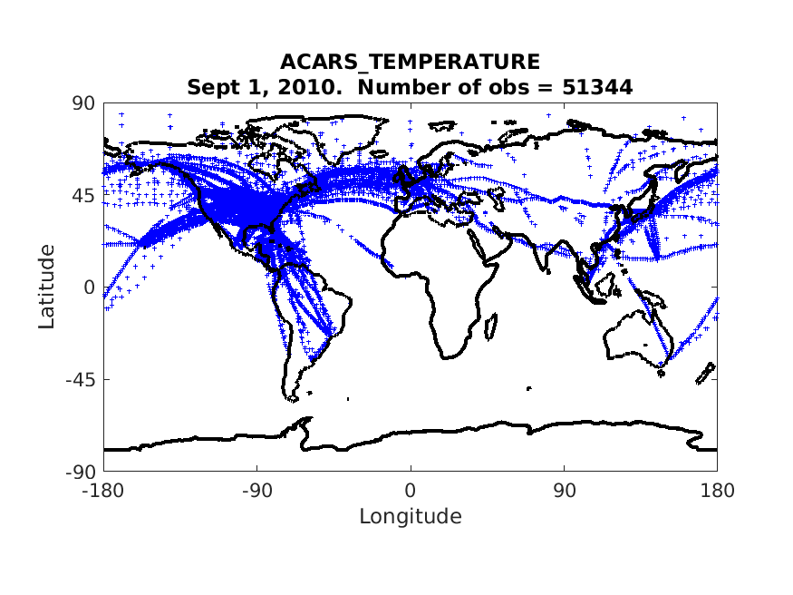
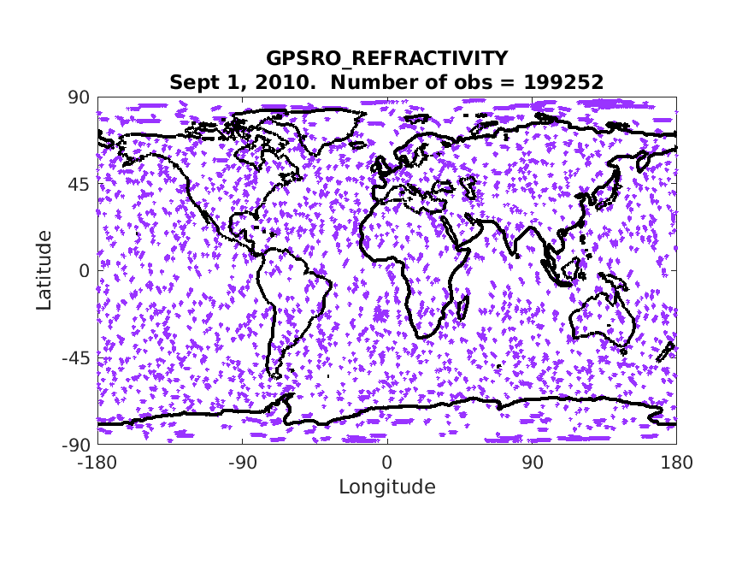
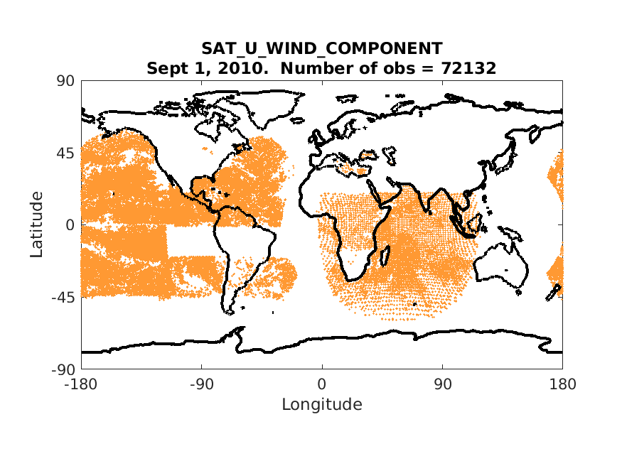
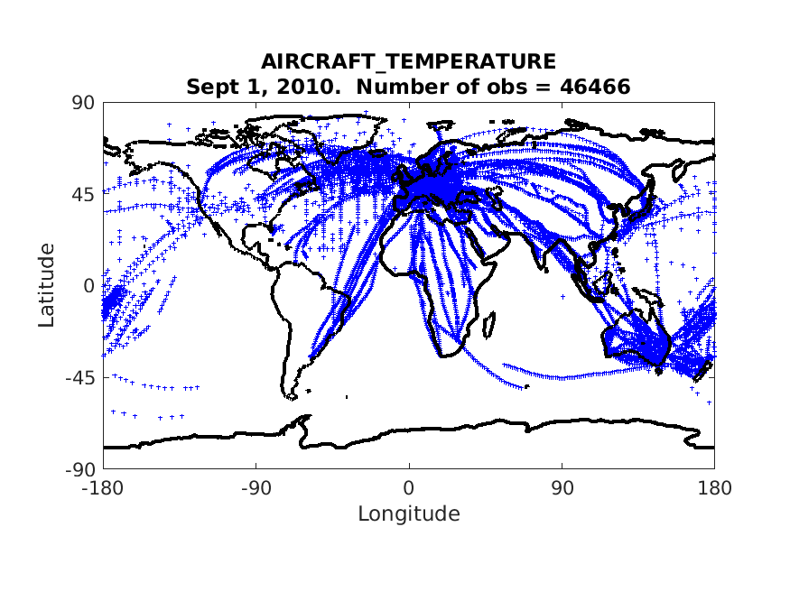
Reanalysis Quick Facts: Observations
Sample of observations used in 1 day; more than 450,000 for this date.
Notes:
I am interested in Ensemble DA which involves running multiple instances of the model that differ only in their initial state –
this represents our uncertainty in our knowledge of the state of the system.
The first public release of DART was in 2004 and the seminal review paper is from 2009.
I want to make sure that we understand each other and when I say ‘data assimilation’ I am referring to confronting a model state with observations and updating the model state to reflect the information in the observations. DART additionally allows one to augment the state with parameters which can be estimated – which is of interest to the rest of the team – but that’s a topic for a different talk.

Slide 7
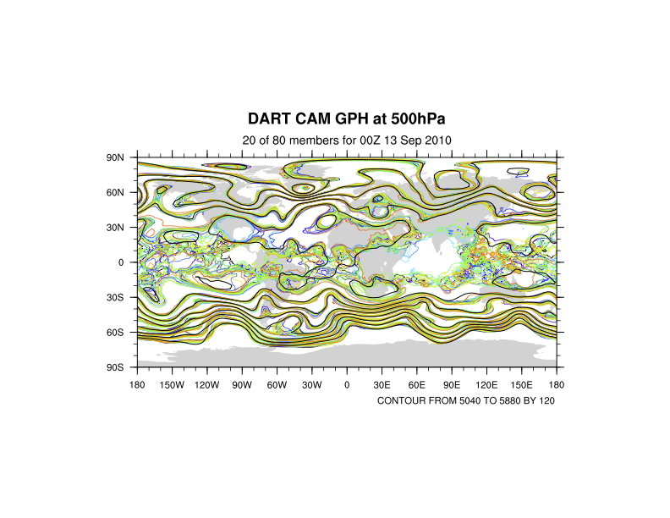
An Ensemble Reanalysis with CAM in CESM: Results
Color contours from DART: Ensemble members (20 of 80) show Uncertainty.
Black from operational NCEP FNL analysis.

Slide 8
An Ensemble Reanalysis with CAM in CESM: Results
Agrees with NCEP where well-observed.
Color contours from DART: Ensemble members (20 of 80) show Uncertainty.
Black from operational NCEP FNL analysis.

Slide 9
An Ensemble Reanalysis with CAM in CESM: Results
Yes, tropical heights are really that uncertain!!!
Color contours from DART: Ensemble members (20 of 80) show Uncertainty.
Black from operational NCEP FNL analysis.

Slide 10
An Ensemble Reanalysis with CAM in CESM: Results
Remote sensing reduces SH uncertainty.
Color contours from DART: Ensemble members (20 of 80) show Uncertainty.
Black from operational NCEP FNL analysis.

Slide 11
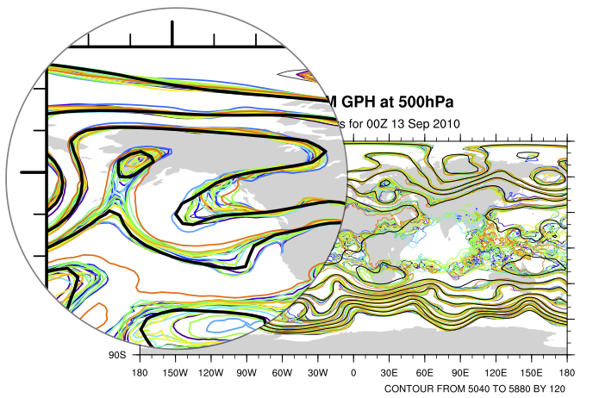
An Ensemble Reanalysis with CAM in CESM: Results
Color contours from DART: Ensemble members (20 of 80) show Uncertainty.
Black from operational NCEP FNL analysis.

Slide 12
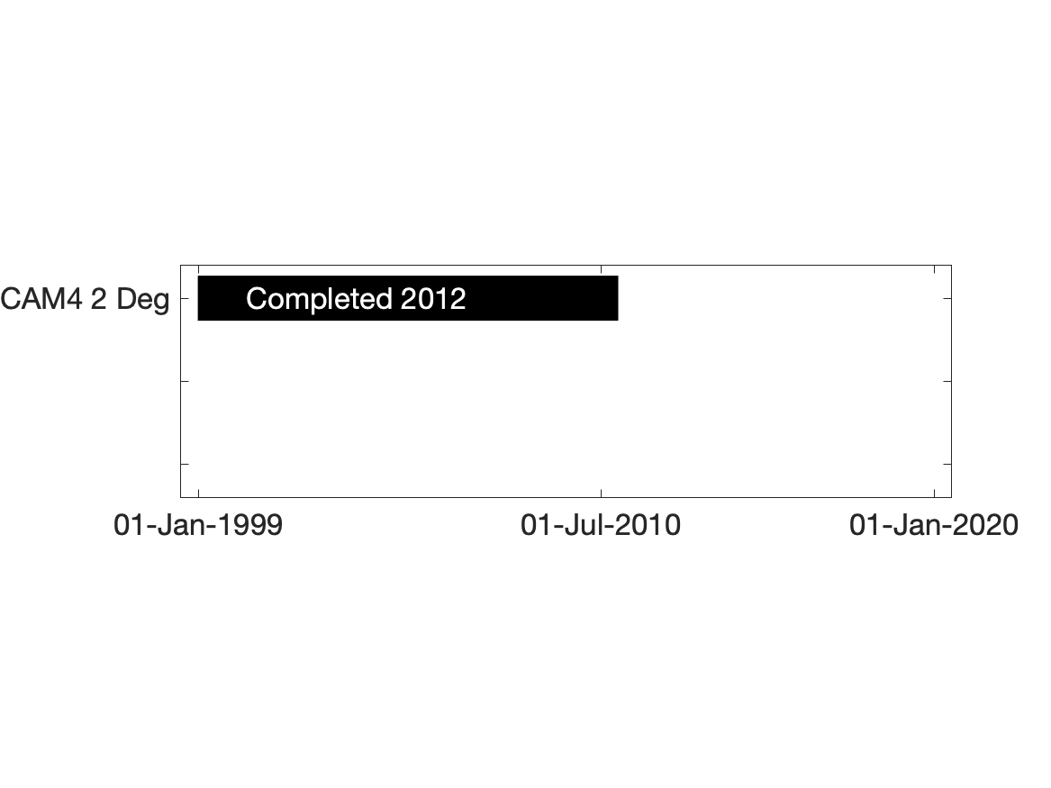
DART/CAM 6 Reanalysis Timeline
Notes:
I am interested in Ensemble DA which involves running multiple instances of the model that differ only in their initial state –
this represents our uncertainty in our knowledge of the state of the system.
The first public release of DART was in 2004 and the seminal review paper is from 2009.
I want to make sure that we understand each other and when I say ‘data assimilation’ I am referring to confronting a model state with observations and updating the model state to reflect the information in the observations. DART additionally allows one to augment the state with parameters which can be estimated – which is of interest to the rest of the team – but that’s a topic for a different talk.

Slide 13
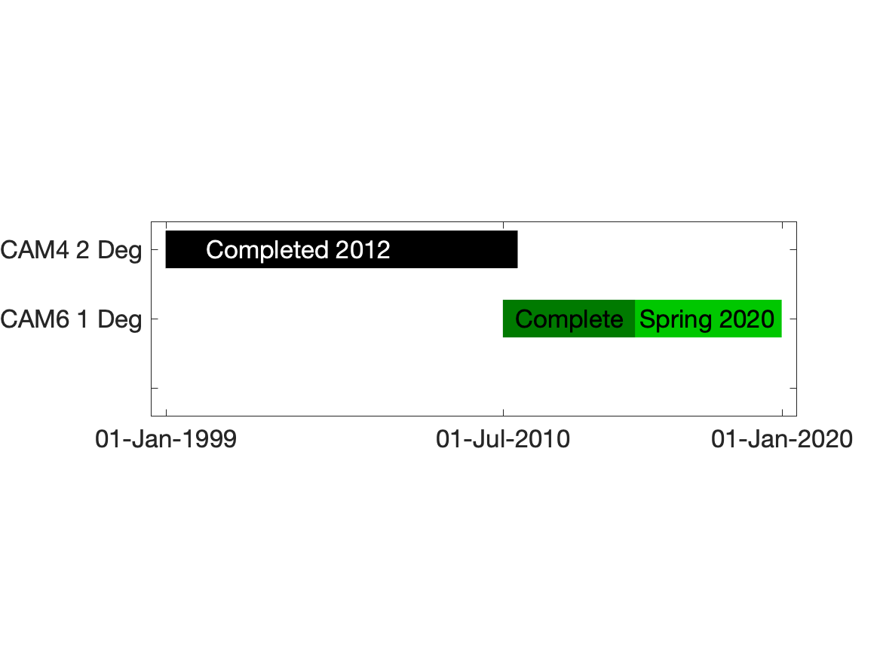
DART/CAM 6 Reanalysis Timeline
CAM 6 Phase 1 Supported by NCAR Strategic Capability (NSC)
Notes:
I am interested in Ensemble DA which involves running multiple instances of the model that differ only in their initial state –
this represents our uncertainty in our knowledge of the state of the system.
The first public release of DART was in 2004 and the seminal review paper is from 2009.
I want to make sure that we understand each other and when I say ‘data assimilation’ I am referring to confronting a model state with observations and updating the model state to reflect the information in the observations. DART additionally allows one to augment the state with parameters which can be estimated – which is of interest to the rest of the team – but that’s a topic for a different talk.

Slide 14
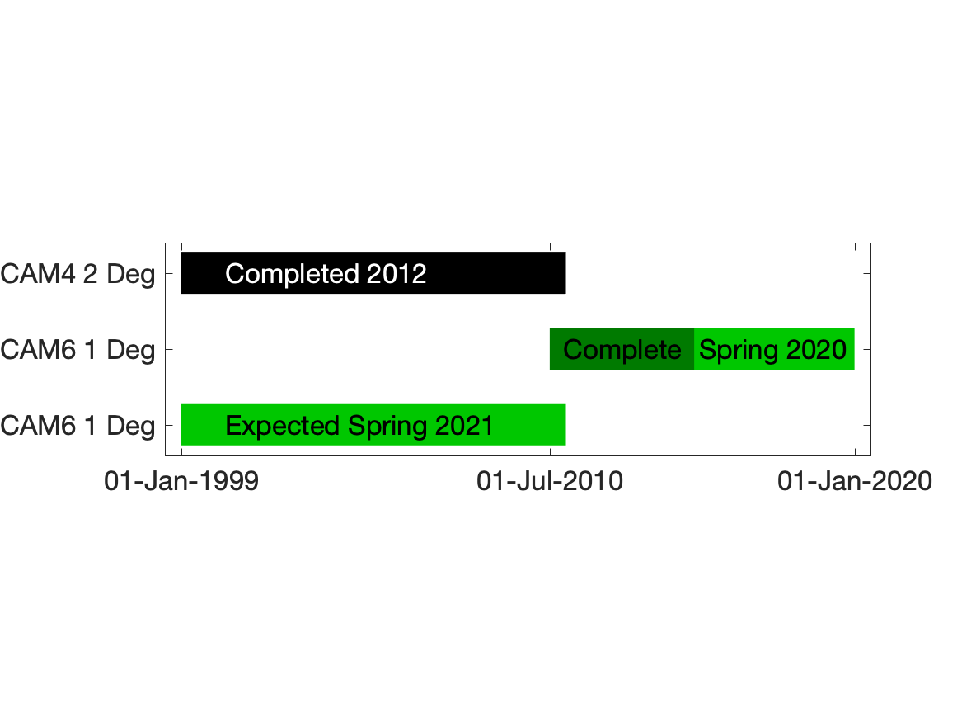
DART/CAM 6 Reanalysis Timeline
CAM 6 Phase 2 Contingent on Additional NCAR Computational Resources
Notes:
I am interested in Ensemble DA which involves running multiple instances of the model that differ only in their initial state –
this represents our uncertainty in our knowledge of the state of the system.
The first public release of DART was in 2004 and the seminal review paper is from 2009.
I want to make sure that we understand each other and when I say ‘data assimilation’ I am referring to confronting a model state with observations and updating the model state to reflect the information in the observations. DART additionally allows one to augment the state with parameters which can be estimated – which is of interest to the rest of the team – but that’s a topic for a different talk.

Slide 15
Products You Can Use
Four output products available as they are completed:
80-Member ensemble of CAM6 initial conditions.
80-Member ensemble of forcing files for other CESM components.
Comparison of CAM6 6-hour forecasts to observations.
Ensemble mean and spread.
Notes:
I am interested in Ensemble DA which involves running multiple instances of the model that differ only in their initial state –
this represents our uncertainty in our knowledge of the state of the system.
The first public release of DART was in 2004 and the seminal review paper is from 2009.
I want to make sure that we understand each other and when I say ‘data assimilation’ I am referring to confronting a model state with observations and updating the model state to reflect the information in the observations. DART additionally allows one to augment the state with parameters which can be estimated – which is of interest to the rest of the team – but that’s a topic for a different talk.

Slide 16
Products You Can Use
1. 80-Member ensemble of CAM6 initial conditions.
Available once per week.
High-quality, 1 degree initial conditions.
Members sample initial condition uncertainty (not ad hoc perturbations).
Consistent with CAM dynamics, minimize forecast spin-up.
Only biases present are from CAM, not another model.
Can be down/up-scaled for different resolutions.
Notes:
I am interested in Ensemble DA which involves running multiple instances of the model that differ only in their initial state –
this represents our uncertainty in our knowledge of the state of the system.
The first public release of DART was in 2004 and the seminal review paper is from 2009.
I want to make sure that we understand each other and when I say ‘data assimilation’ I am referring to confronting a model state with observations and updating the model state to reflect the information in the observations. DART additionally allows one to augment the state with parameters which can be estimated – which is of interest to the rest of the team – but that’s a topic for a different talk.

Slide 17
Products You Can Use
2. 80-Member ensemble of forcing files for other CESM components.
Available hourly to daily as appropriate for each variable.
Provide forcing for ensemble simulations or data assimilation.
Can be used directly with CESM coupler to force:
POP (MOM)
CLM/CTSM
CICE
Physically-consistent, realistic, balanced for CESM use.
Realistic ensemble uncertainty consistent with observing network.
Notes:
I am interested in Ensemble DA which involves running multiple instances of the model that differ only in their initial state –
this represents our uncertainty in our knowledge of the state of the system.
The first public release of DART was in 2004 and the seminal review paper is from 2009.
I want to make sure that we understand each other and when I say ‘data assimilation’ I am referring to confronting a model state with observations and updating the model state to reflect the information in the observations. DART additionally allows one to augment the state with parameters which can be estimated – which is of interest to the rest of the team – but that’s a topic for a different talk.

Slide 18
Products You Can Use
2. 80-Member ensemble of forcing files for other CESM components.
Black is ensemble mean.
Notes:
I am interested in Ensemble DA which involves running multiple instances of the model that differ only in their initial state –
this represents our uncertainty in our knowledge of the state of the system.
The first public release of DART was in 2004 and the seminal review paper is from 2009.
I want to make sure that we understand each other and when I say ‘data assimilation’ I am referring to confronting a model state with observations and updating the model state to reflect the information in the observations. DART additionally allows one to augment the state with parameters which can be estimated – which is of interest to the rest of the team – but that’s a topic for a different talk.

Slide 19
Products You Can Use
2. 80-Member ensemble of forcing files for other CESM components.
Black is ensemble mean.
Notes:
I am interested in Ensemble DA which involves running multiple instances of the model that differ only in their initial state –
this represents our uncertainty in our knowledge of the state of the system.
The first public release of DART was in 2004 and the seminal review paper is from 2009.
I want to make sure that we understand each other and when I say ‘data assimilation’ I am referring to confronting a model state with observations and updating the model state to reflect the information in the observations. DART additionally allows one to augment the state with parameters which can be estimated – which is of interest to the rest of the team – but that’s a topic for a different talk.

Slide 20
Products You Can Use
2. 80-Member ensemble of forcing files for other CESM components.
Black is ensemble mean.
Notes:
I am interested in Ensemble DA which involves running multiple instances of the model that differ only in their initial state –
this represents our uncertainty in our knowledge of the state of the system.
The first public release of DART was in 2004 and the seminal review paper is from 2009.
I want to make sure that we understand each other and when I say ‘data assimilation’ I am referring to confronting a model state with observations and updating the model state to reflect the information in the observations. DART additionally allows one to augment the state with parameters which can be estimated – which is of interest to the rest of the team – but that’s a topic for a different talk.

Slide 21
Products You Can Use
2. 80-Member ensemble of forcing files for other CESM components.
Black is ensemble mean.
Notes:
I am interested in Ensemble DA which involves running multiple instances of the model that differ only in their initial state –
this represents our uncertainty in our knowledge of the state of the system.
The first public release of DART was in 2004 and the seminal review paper is from 2009.
I want to make sure that we understand each other and when I say ‘data assimilation’ I am referring to confronting a model state with observations and updating the model state to reflect the information in the observations. DART additionally allows one to augment the state with parameters which can be estimated – which is of interest to the rest of the team – but that’s a topic for a different talk.

Slide 22
Products You Can Use
3. Comparison of CAM6 6-hour forecasts to observations.
Available every 6 hours.
Reveal CAM6 model systematic differences from observations.
Short-term systematic errors often related to longer-term.
Can focus on specific regions and quantities.
Helpful as baseline for new model development.
Notes:
I am interested in Ensemble DA which involves running multiple instances of the model that differ only in their initial state –
this represents our uncertainty in our knowledge of the state of the system.
The first public release of DART was in 2004 and the seminal review paper is from 2009.
I want to make sure that we understand each other and when I say ‘data assimilation’ I am referring to confronting a model state with observations and updating the model state to reflect the information in the observations. DART additionally allows one to augment the state with parameters which can be estimated – which is of interest to the rest of the team – but that’s a topic for a different talk.

Slide 23
Products You Can Use
3. Comparison of CAM6 6-hour forecasts to observations.
Example: SH Temperature profiles, September 2010.
RMSE
Bias
Notes:
I am interested in Ensemble DA which involves running multiple instances of the model that differ only in their initial state –
this represents our uncertainty in our knowledge of the state of the system.
The first public release of DART was in 2004 and the seminal review paper is from 2009.
I want to make sure that we understand each other and when I say ‘data assimilation’ I am referring to confronting a model state with observations and updating the model state to reflect the information in the observations. DART additionally allows one to augment the state with parameters which can be estimated – which is of interest to the rest of the team – but that’s a topic for a different talk.

Slide 24
Products You Can Use
3. Comparison of CAM6 6-hour forecasts to observations.
Example: SH Temperature profiles, September 2010.
Obs. Available
Obs Assimilated
Notes:
I am interested in Ensemble DA which involves running multiple instances of the model that differ only in their initial state –
this represents our uncertainty in our knowledge of the state of the system.
The first public release of DART was in 2004 and the seminal review paper is from 2009.
I want to make sure that we understand each other and when I say ‘data assimilation’ I am referring to confronting a model state with observations and updating the model state to reflect the information in the observations. DART additionally allows one to augment the state with parameters which can be estimated – which is of interest to the rest of the team – but that’s a topic for a different talk.

Slide 25
Products You Can Use
3. Comparison of CAM6 6-hour forecasts to observations.
Example: SH Temperature profiles, September 2010.
RMSE
Total
Spread
Notes:
I am interested in Ensemble DA which involves running multiple instances of the model that differ only in their initial state –
this represents our uncertainty in our knowledge of the state of the system.
The first public release of DART was in 2004 and the seminal review paper is from 2009.
I want to make sure that we understand each other and when I say ‘data assimilation’ I am referring to confronting a model state with observations and updating the model state to reflect the information in the observations. DART additionally allows one to augment the state with parameters which can be estimated – which is of interest to the rest of the team – but that’s a topic for a different talk.

Slide 26
Products You Can Use
3. Comparison of CAM6 6-hour forecasts to observations.
Example: NH AIRS Spec. Humidity, upper troposphere, Sept. 2010.
Notes:
I am interested in Ensemble DA which involves running multiple instances of the model that differ only in their initial state –
this represents our uncertainty in our knowledge of the state of the system.
The first public release of DART was in 2004 and the seminal review paper is from 2009.
I want to make sure that we understand each other and when I say ‘data assimilation’ I am referring to confronting a model state with observations and updating the model state to reflect the information in the observations. DART additionally allows one to augment the state with parameters which can be estimated – which is of interest to the rest of the team – but that’s a topic for a different talk.

Slide 27
Products You Can Use
3. Comparison of CAM6 6-hour forecasts to observations.
Example: SH GPS RO, upper troposphere, Sept. 2010.
Notes:
I am interested in Ensemble DA which involves running multiple instances of the model that differ only in their initial state –
this represents our uncertainty in our knowledge of the state of the system.
The first public release of DART was in 2004 and the seminal review paper is from 2009.
I want to make sure that we understand each other and when I say ‘data assimilation’ I am referring to confronting a model state with observations and updating the model state to reflect the information in the observations. DART additionally allows one to augment the state with parameters which can be estimated – which is of interest to the rest of the team – but that’s a topic for a different talk.

Slide 28
Products You Can Use
3. Comparison of CAM6/CAM4 6-hour forecasts to observations.
Example: SH Temperature profiles, August 2010.
CAM4
CAM6
Sample Only: Do not use for science applications.
Notes:
I am interested in Ensemble DA which involves running multiple instances of the model that differ only in their initial state –
this represents our uncertainty in our knowledge of the state of the system.
The first public release of DART was in 2004 and the seminal review paper is from 2009.
I want to make sure that we understand each other and when I say ‘data assimilation’ I am referring to confronting a model state with observations and updating the model state to reflect the information in the observations. DART additionally allows one to augment the state with parameters which can be estimated – which is of interest to the rest of the team – but that’s a topic for a different talk.

Slide 29
Atmospheric ensemble reanalysis essential for CLM, CICE, POP DA
Want to do ensemble DA for other CESM components:
Land, ice and ocean are strongly forced by atmosphere.
Single deterministic forcing leads to loss of variability.
Loss of variability is key challenge to ensemble DA.
Example for CLM ensemble makes this clear.

Slide 30

Initializing carbon cycle predictions from CLM by assimilating biomass and LAI observations
Andrew Fox^{1,2}, Tim Hoar², William Kolby-Smith¹,
Jeffrey Anderson² & David Moore¹
University of Arizona
National Center for Atmospheric Research

Slide 31
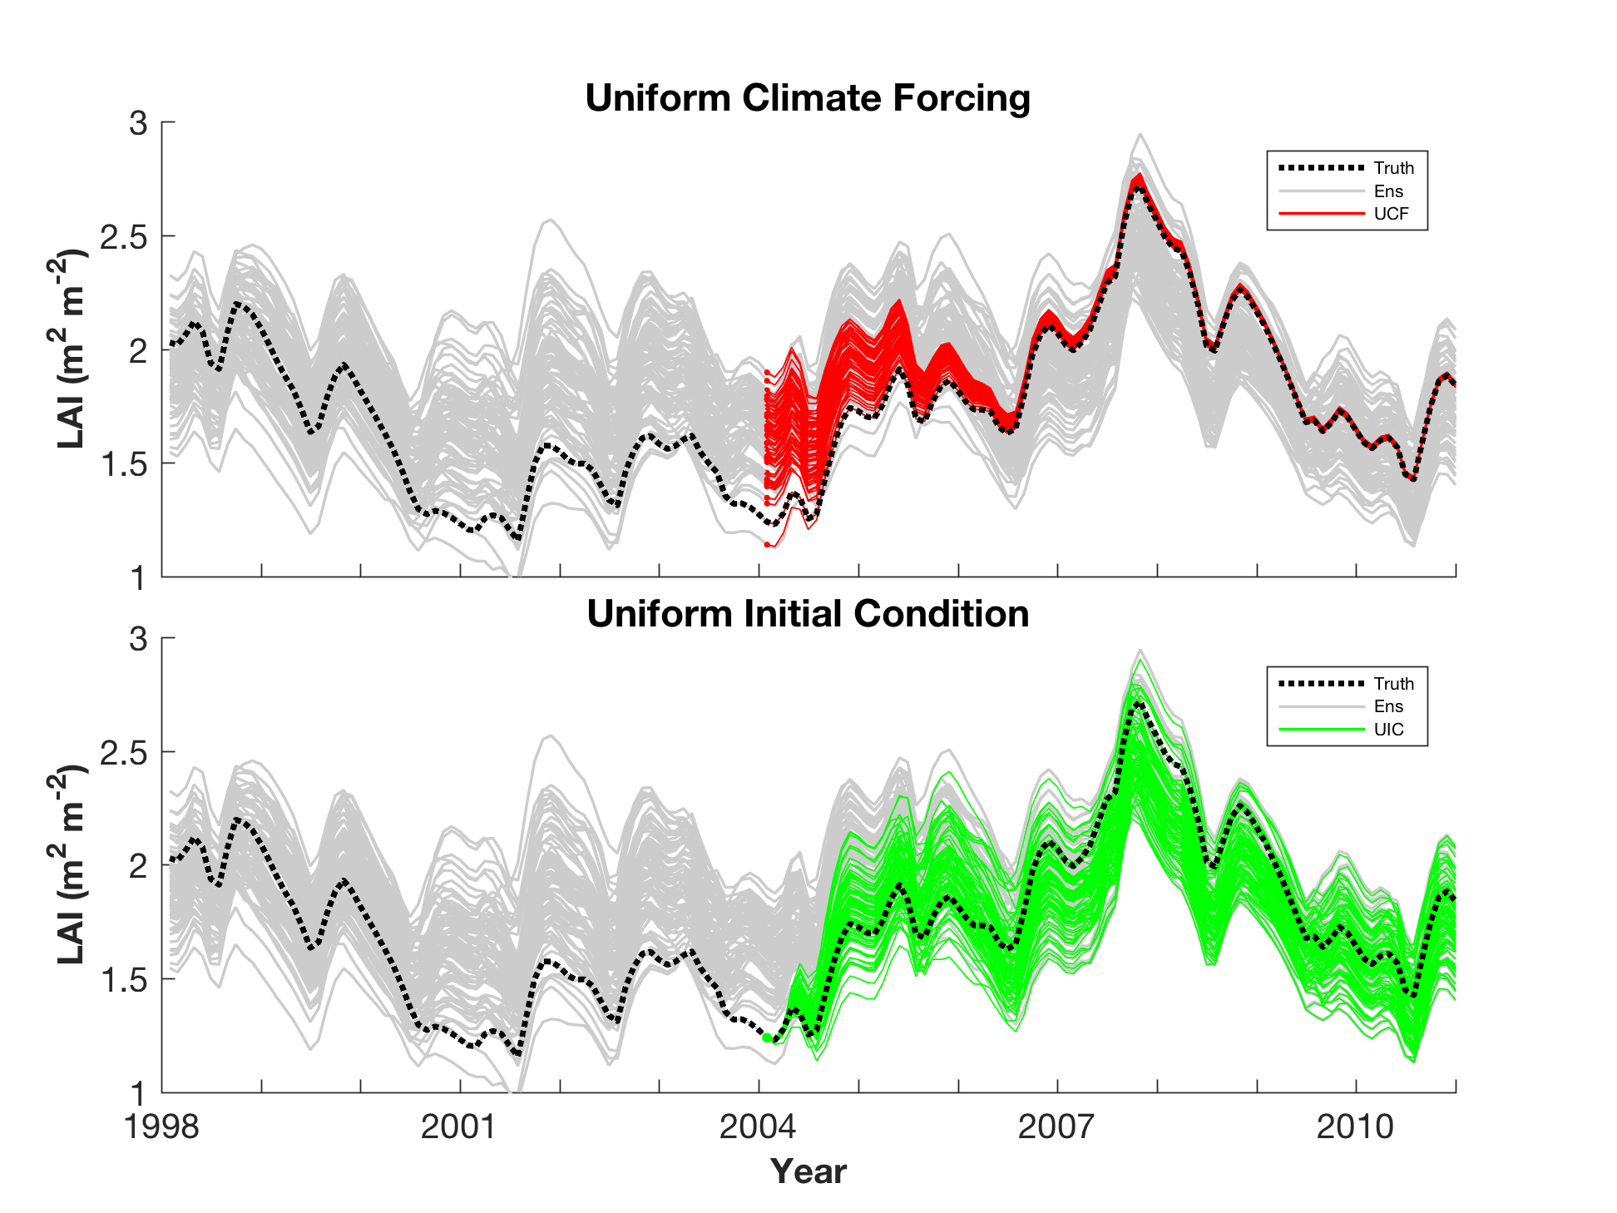
Uniform Climate Forcing v. Initial Conditions
Ensemble Integrations of CLM 4.5.
Single forcing leads to ensemble collapse.

Slide 32
Who’s doing the work?
Kevin Raeder: Overall project lead, keeps everything running (really hard).
This has been essentially 24/7 for 6 months so far.
Nancy Collins: Observations, software engineering.
Tim Hoar: Diagnostics, support for forcing other components.
Moha El Gharamti: Improved DART inflation, DART tuning.
Jeff Anderson: Organizational support.
All: Product evaluation and quality monitoring.
A National Lab with dedicated support staff is really required to do this.
Notes:
I am interested in Ensemble DA which involves running multiple instances of the model that differ only in their initial state –
this represents our uncertainty in our knowledge of the state of the system.
The first public release of DART was in 2004 and the seminal review paper is from 2009.
I want to make sure that we understand each other and when I say ‘data assimilation’ I am referring to confronting a model state with observations and updating the model state to reflect the information in the observations. DART additionally allows one to augment the state with parameters which can be estimated – which is of interest to the rest of the team – but that’s a topic for a different talk.

Slide 33
This is a Demanding Computational Task
Phase 1 of CAM6 requires the following resources:
Computation:
240 nodes on NCAR’s Cheyenne supercomputer.
Approximately 18 million core hours.
Storage:
Forcing files: 18.2 Tb
Weekly ensemble restarts: 80 Tb
Notes:
I am interested in Ensemble DA which involves running multiple instances of the model that differ only in their initial state –
this represents our uncertainty in our knowledge of the state of the system.
The first public release of DART was in 2004 and the seminal review paper is from 2009.
I want to make sure that we understand each other and when I say ‘data assimilation’ I am referring to confronting a model state with observations and updating the model state to reflect the information in the observations. DART additionally allows one to augment the state with parameters which can be estimated – which is of interest to the rest of the team – but that’s a topic for a different talk.

Slide 34
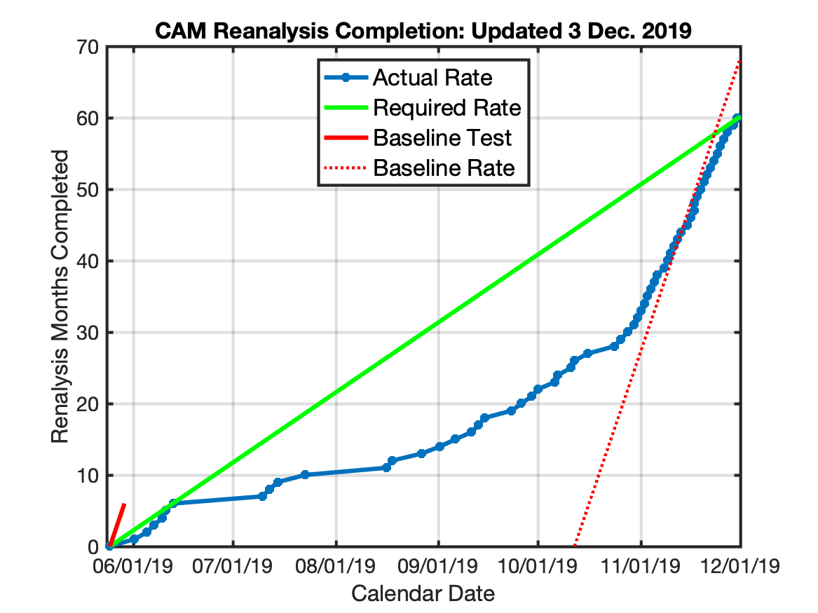
This is a Demanding Computational Task
Cheyenne Down for Upgrades
Start of Dedicated Queue
Notes:
I am interested in Ensemble DA which involves running multiple instances of the model that differ only in their initial state –
this represents our uncertainty in our knowledge of the state of the system.
The first public release of DART was in 2004 and the seminal review paper is from 2009.
I want to make sure that we understand each other and when I say ‘data assimilation’ I am referring to confronting a model state with observations and updating the model state to reflect the information in the observations. DART additionally allows one to augment the state with parameters which can be estimated – which is of interest to the rest of the team – but that’s a topic for a different talk.

Slide 35
TIME CRITICAL REQUEST
What other output would people like?
Periods with more frequent ensemble state output?
Forcing for off-line chemistry simulations/DA,
Forcing for simulations/DA of models above troposphere,
Boundary forcing for regional simulations/DA (WRF, MPAS…),
Baseline for DA experiments with deeper atmosphere models.
Other diagnostic output???
Contact us at dart@ucar.edu
The wheels are turning, don’t delay.
Notes:
I am interested in Ensemble DA which involves running multiple instances of the model that differ only in their initial state –
this represents our uncertainty in our knowledge of the state of the system.
The first public release of DART was in 2004 and the seminal review paper is from 2009.
I want to make sure that we understand each other and when I say ‘data assimilation’ I am referring to confronting a model state with observations and updating the model state to reflect the information in the observations. DART additionally allows one to augment the state with parameters which can be estimated – which is of interest to the rest of the team – but that’s a topic for a different talk.

Slide 36


For more information:
GCOM
CAM-Chem
PBL_1d
ROMS
NOAH-MP
CAM
GITM
WRF-Hydro
CICE
WACCM
CLM
POP
AM2
BGRID
SQG
COAMPS
www.image.ucar.edu/DAReS/DART
dart@ucar.edu
WRF
MITgcm_ocean
MPAS_ATM
WACCM-X
NCOMMAS
MPAS_OCN
TIEGCM
COAMPS_nest
WRF-Chem
NAAPS
PE2LYR
CABLE
CM1
We would like to acknowledge high-performance computing support from Cheyenne (doi:10.5065/D6RX99HX) provided by NCAR's Computational and Information Systems Laboratory, sponsored by the National Science Foundation.

Slide 37
An Ensemble Reanalysis with CAM in CESM: Results
Hurricane Earl. Headed for Canada.
That’s hurricane Earl (2010).
Even at 1 degree, CAM6 provides good position.
A bit weak but still a hurricane.
Notes:
I am interested in Ensemble DA which involves running multiple instances of the model that differ only in their initial state –
this represents our uncertainty in our knowledge of the state of the system.
The first public release of DART was in 2004 and the seminal review paper is from 2009.
I want to make sure that we understand each other and when I say ‘data assimilation’ I am referring to confronting a model state with observations and updating the model state to reflect the information in the observations. DART additionally allows one to augment the state with parameters which can be estimated – which is of interest to the rest of the team – but that’s a topic for a different talk.

Slide 38
DART/CESM Assimilation
DART Multiple Component Data Assimilation
Started with CCSM4 20th Century 30-member ensemble for all model components
COUPLER
CAM
Important!
There are multiple instances of each model component.
CLM
DART
POP
DART
DART
DART
observations
ROF
CICE
DART assimilates
observations into components separately
Coupler moves the components to the
next time step

